Slide 1
ELECTRONIC CUBE
ELECTRONIC LAB PROJECT
Juan Carlos Rodríguez Tallón, Gabriel González Rial

Slide 2
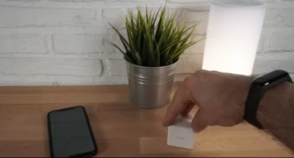
Introduction
Objective
Electronic cube based on Xiaomi AQara
Wireless
Commercial use → Home automation
Own use → Web server and monitoring

Slide 3
Components
Components | Manufacturer | Units | Price (€) | Description
FT232RL-REEL | FTDI | 1 | 3,76 | USB – UART converter
ESP8266-12-E | AI Thinker | 1 | 1 | WiFi Module
MPU-6050 | Invensense | 1 | 7 | Accelerometer/Gyroscope
BC846BWT1G | ON Semiconductor | 5 | 0,6 | General purpose bipolar NPN
NCP1117ST33T3G | ON Semiconductor | 5 | 1,82 | 3,3 V regulator
KM-23ID-F | Kingbright | 15 | 2,06 | LED
MCABT-408-RC | Multicomp | 1 | 0,97 | Buzzer
FSM2JSMASTR | TE Connectivity | 5 | 0,92 | Buttons
PMEG3020DEP | Nexperia | 5 | 1,76 | Schottky diodes
ZX62RD-AB-5P8(30) | Molex | 2 | 0,778 | Micro USB connector
Other components:
Resistors 68, 1k, 4.7k, 12k
Capacitors 10nF, 2.2nF, 100nF, 10uF, 47uF
TOTAL COMPONENTS: 23,83 €
TOTAL PCB: 19,24 €

Slide 4
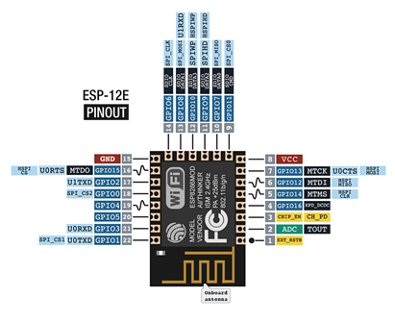
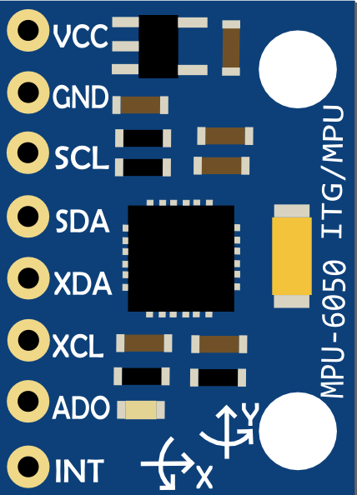
Components
ESP8266-12-E
MPU-6050

Slide 5
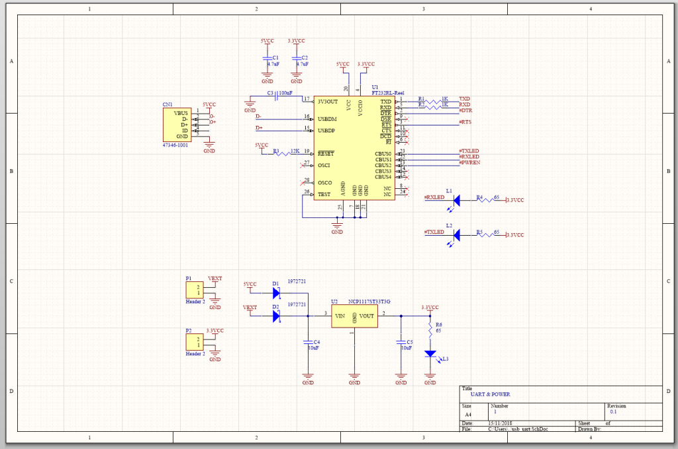
Schematic. UART & Power
MOSFET (n in parallel)

Slide 6
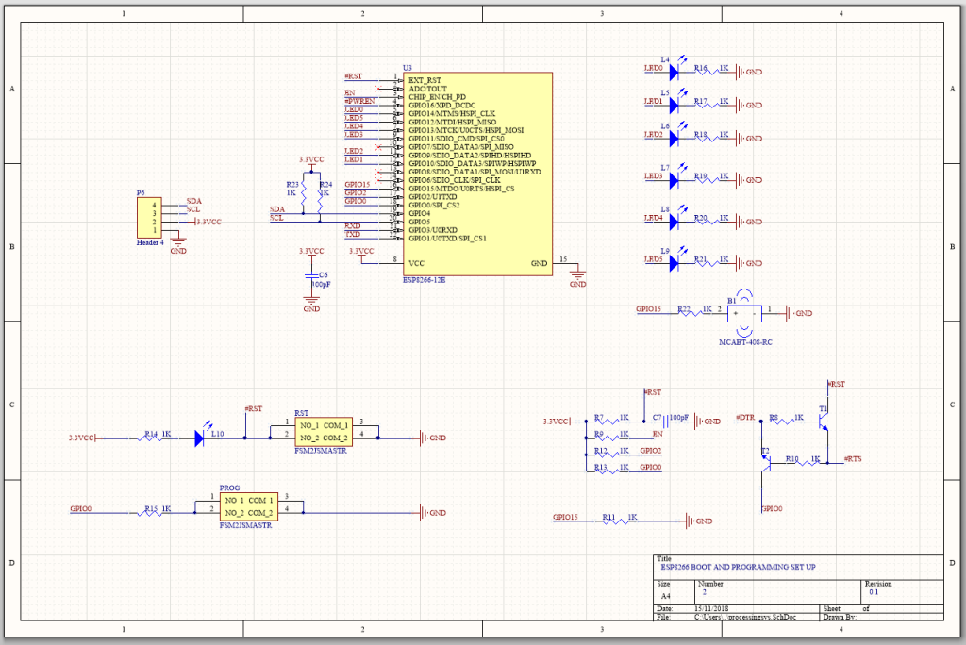
Schematic. ESP 8266-12E

Slide 7
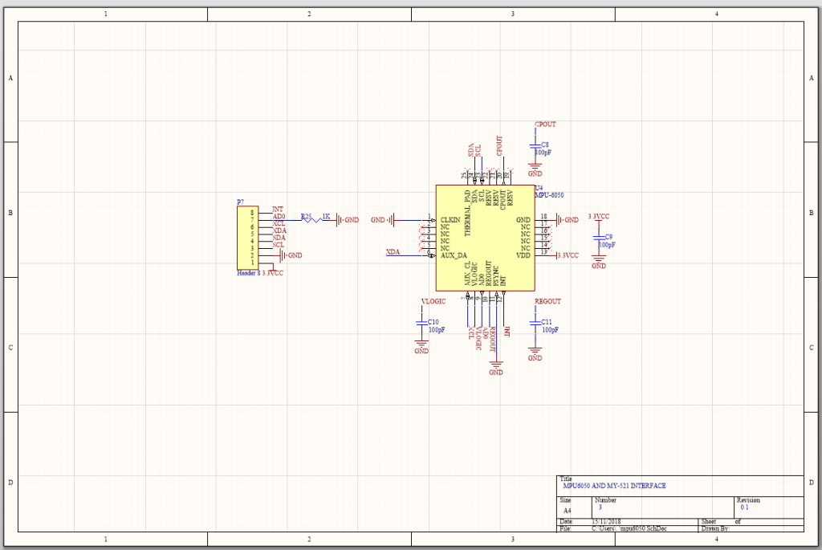
Schematic. MPU6050

Slide 8
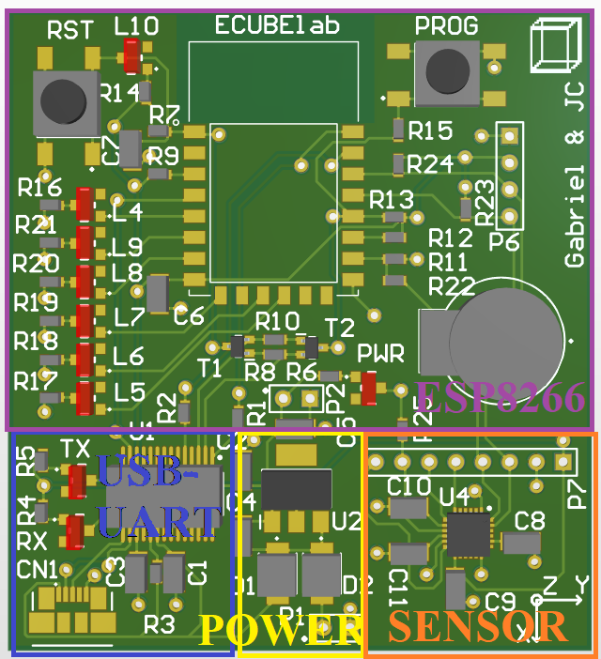
Layout. Distribution

Slide 9
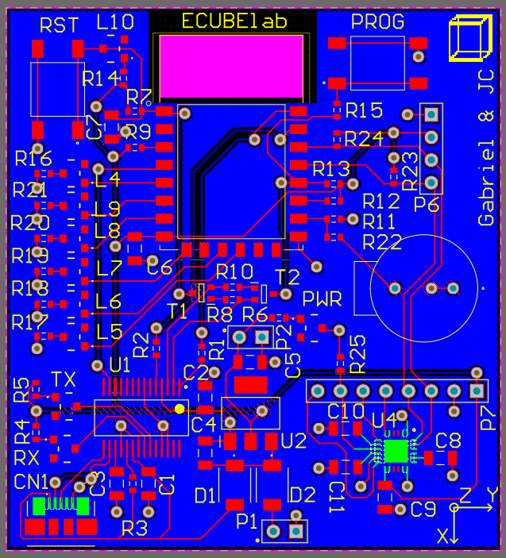
Layout. Routing

Slide 10
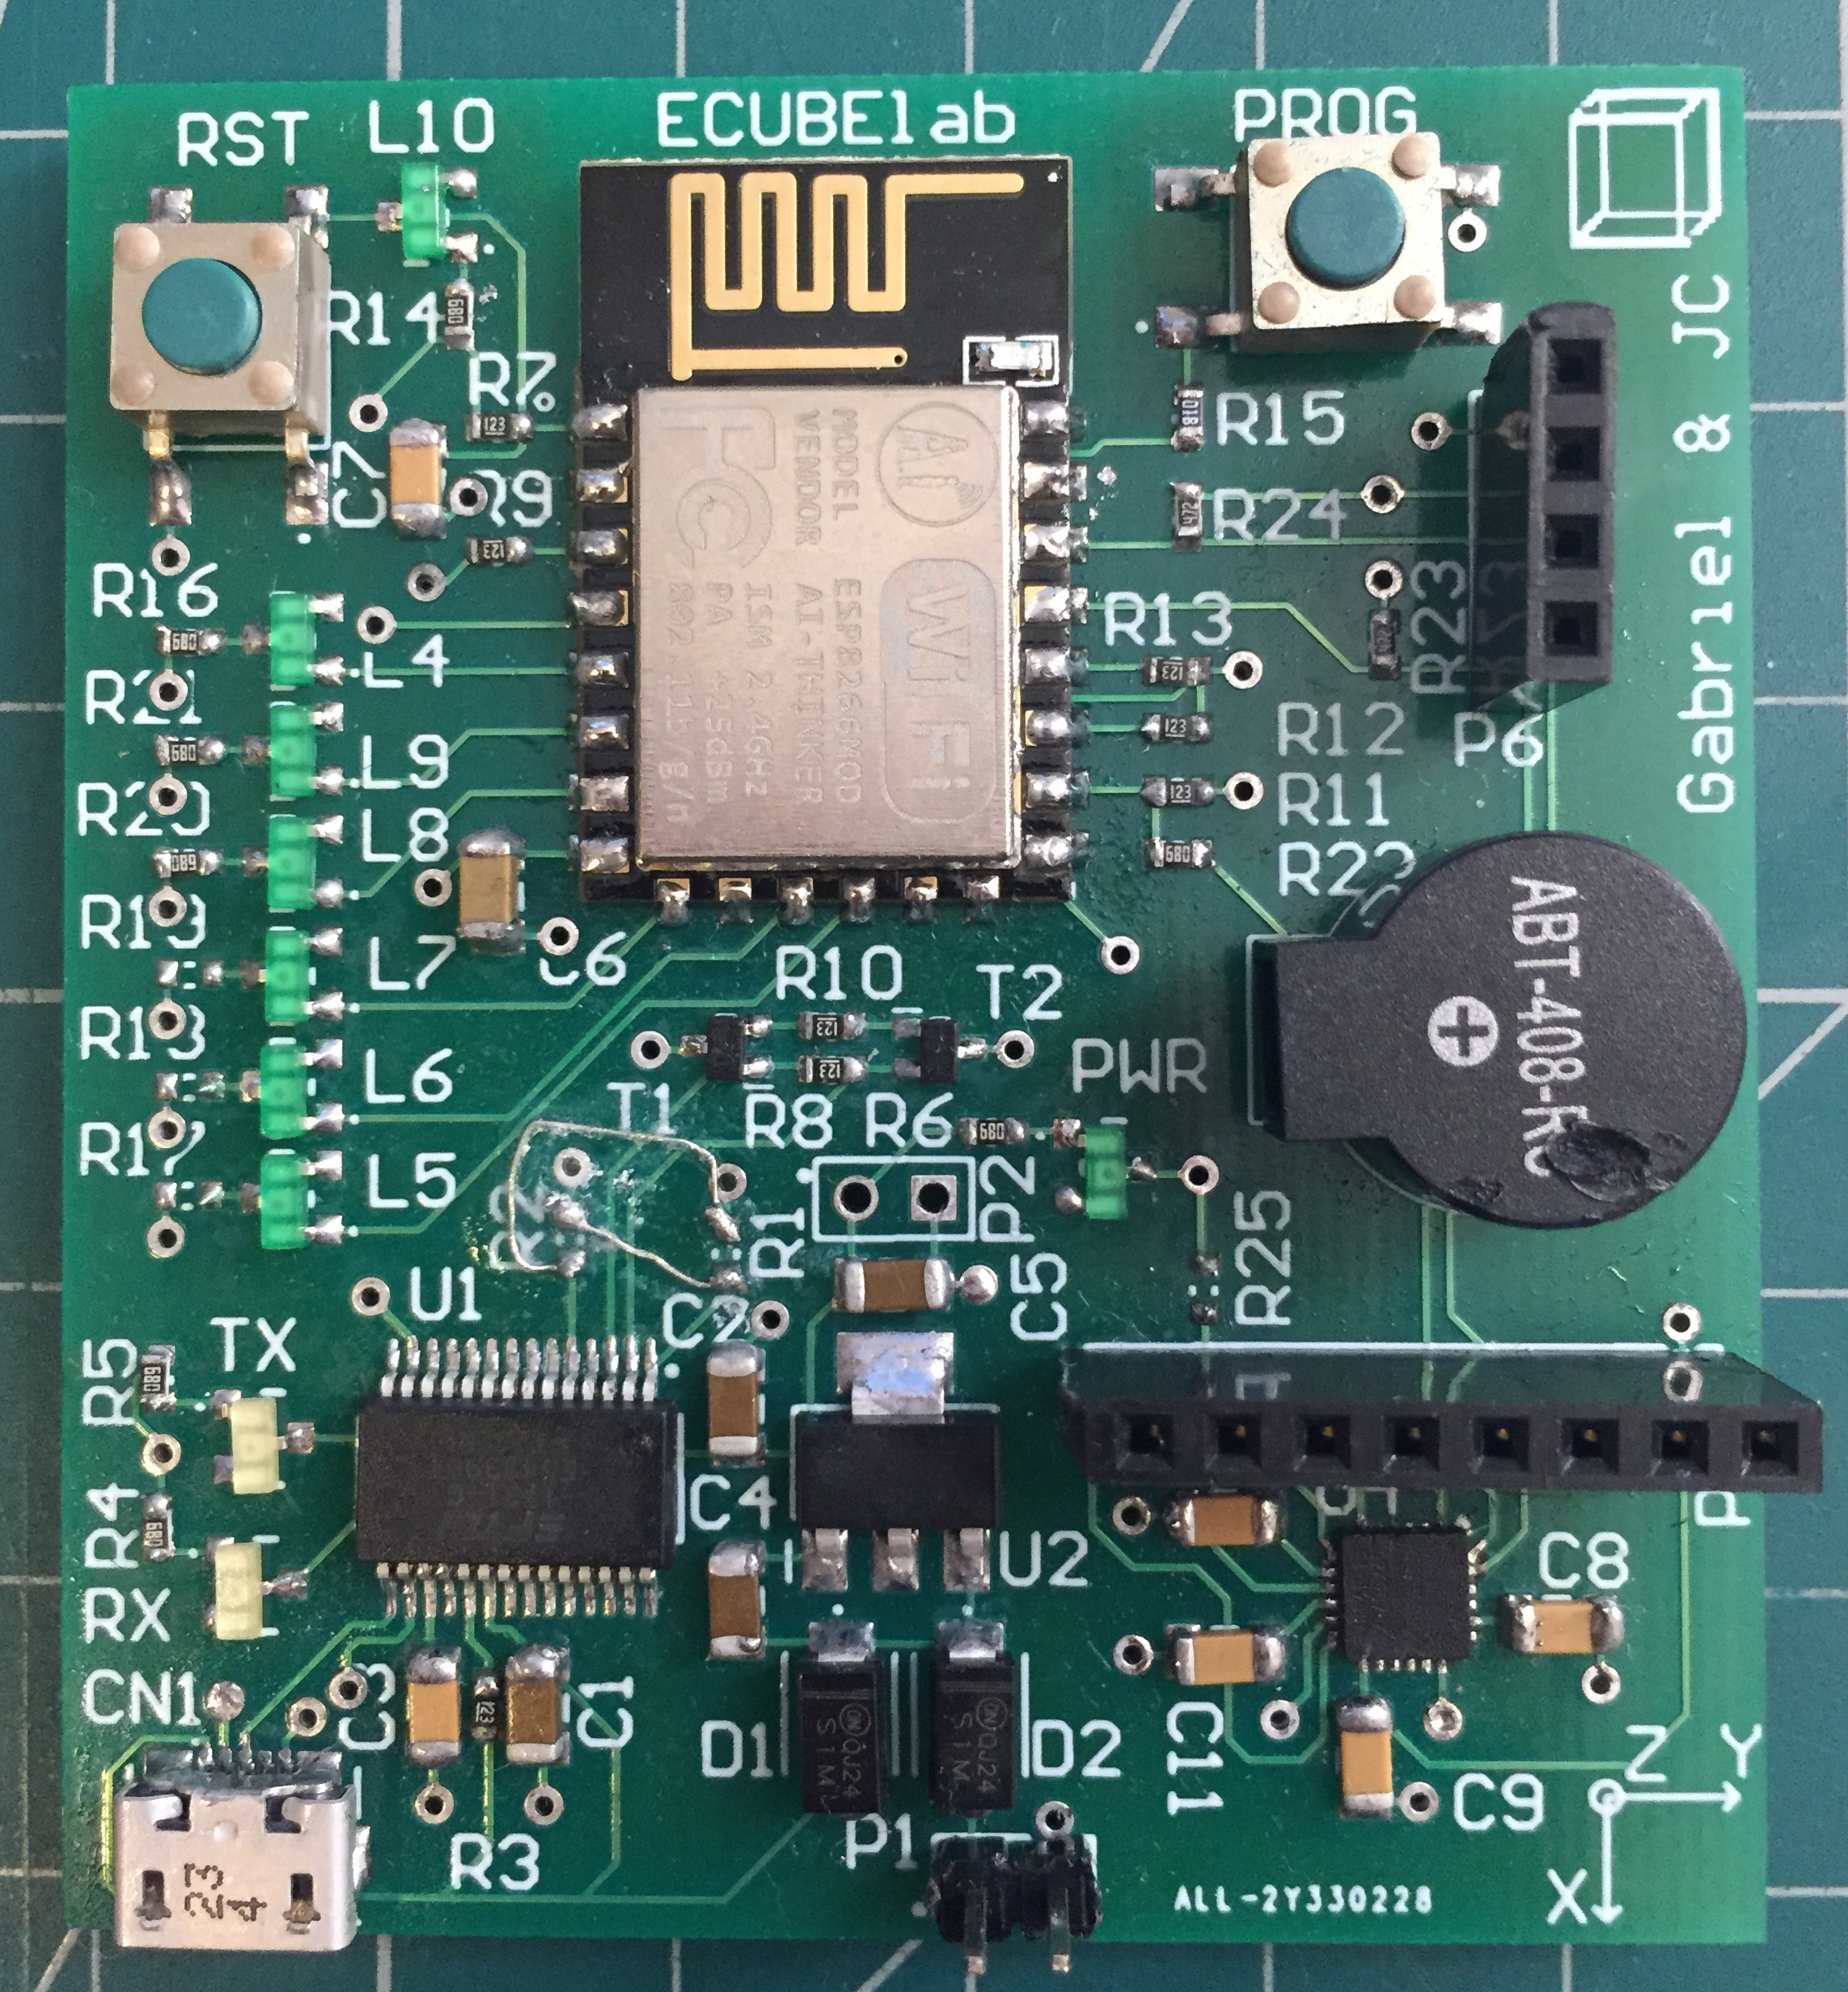
Validation & Test. PCB
Power 5V-3,3V
USB-UART
Programming Interface
WIFI Interface
LEDs
Buzzer and PWM
I2C
MPU6050
OLED Screen

Slide 11
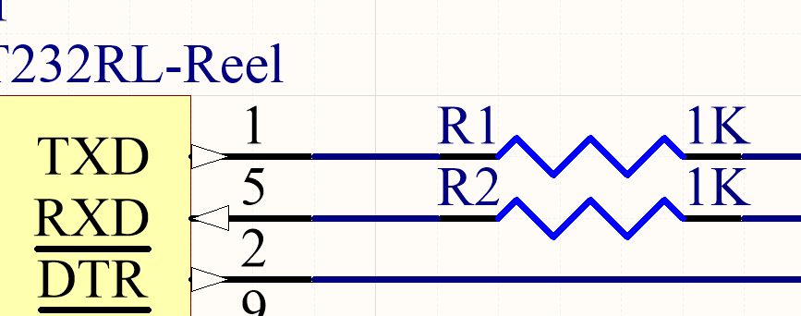
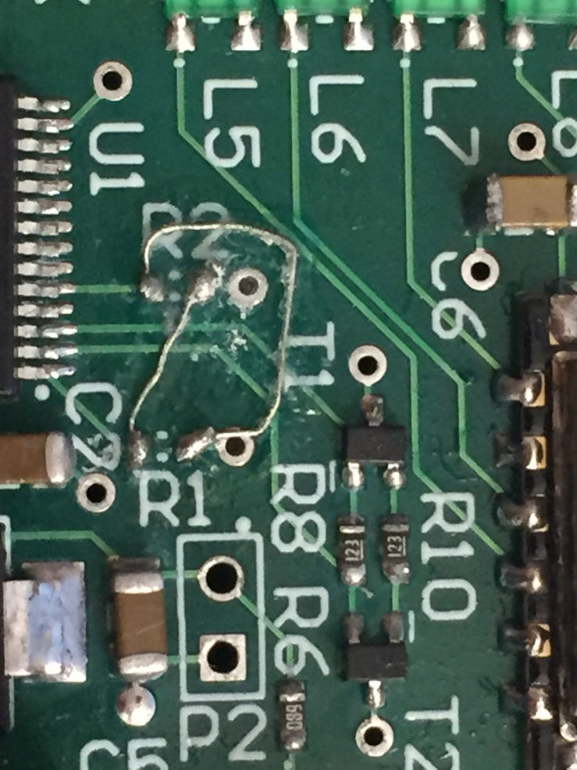
UART
Inverted UART signals
Fixed using R1,R2 Pads

Slide 12
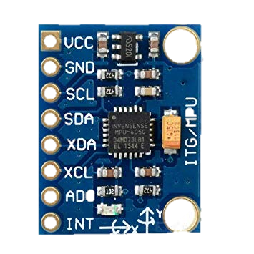
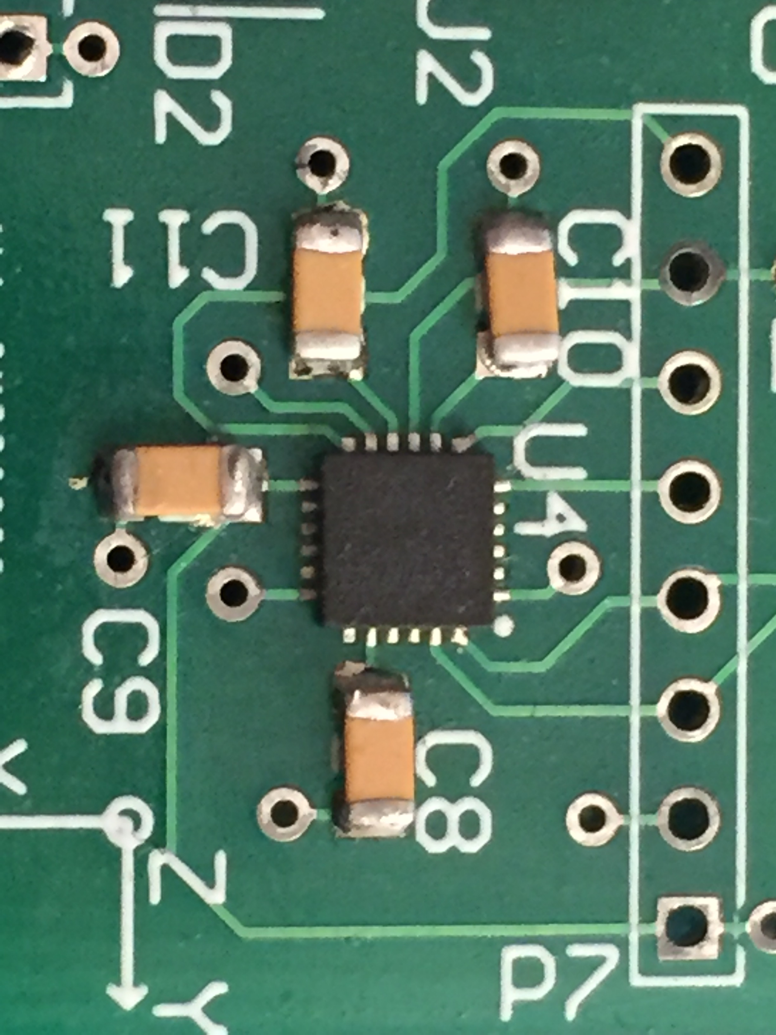
MPU6050
No I2C response after soldering
Aliexpress…¯\_(ツ)_/¯
We left other interface
Use comertial module gy-521

Slide 13



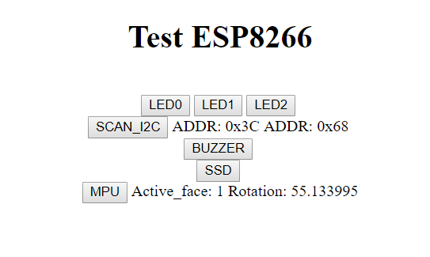
Unitary Tests
Web Interface to deploy Unitary Tests
HTTP Server
Port 80
Toggle Led
Scan I2C Bus
Buzzer
Test Screen
Accelerometer Data

Slide 14
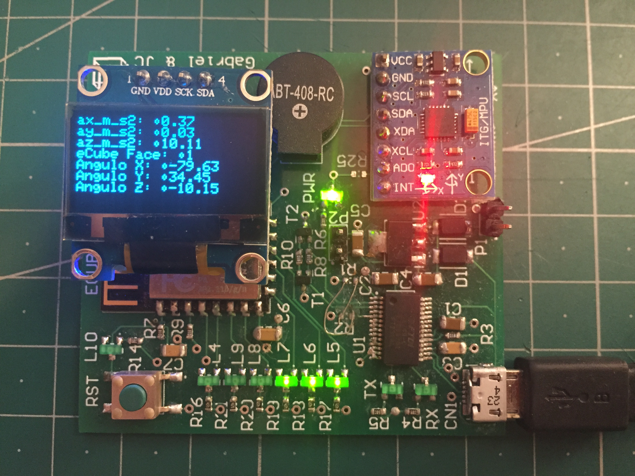
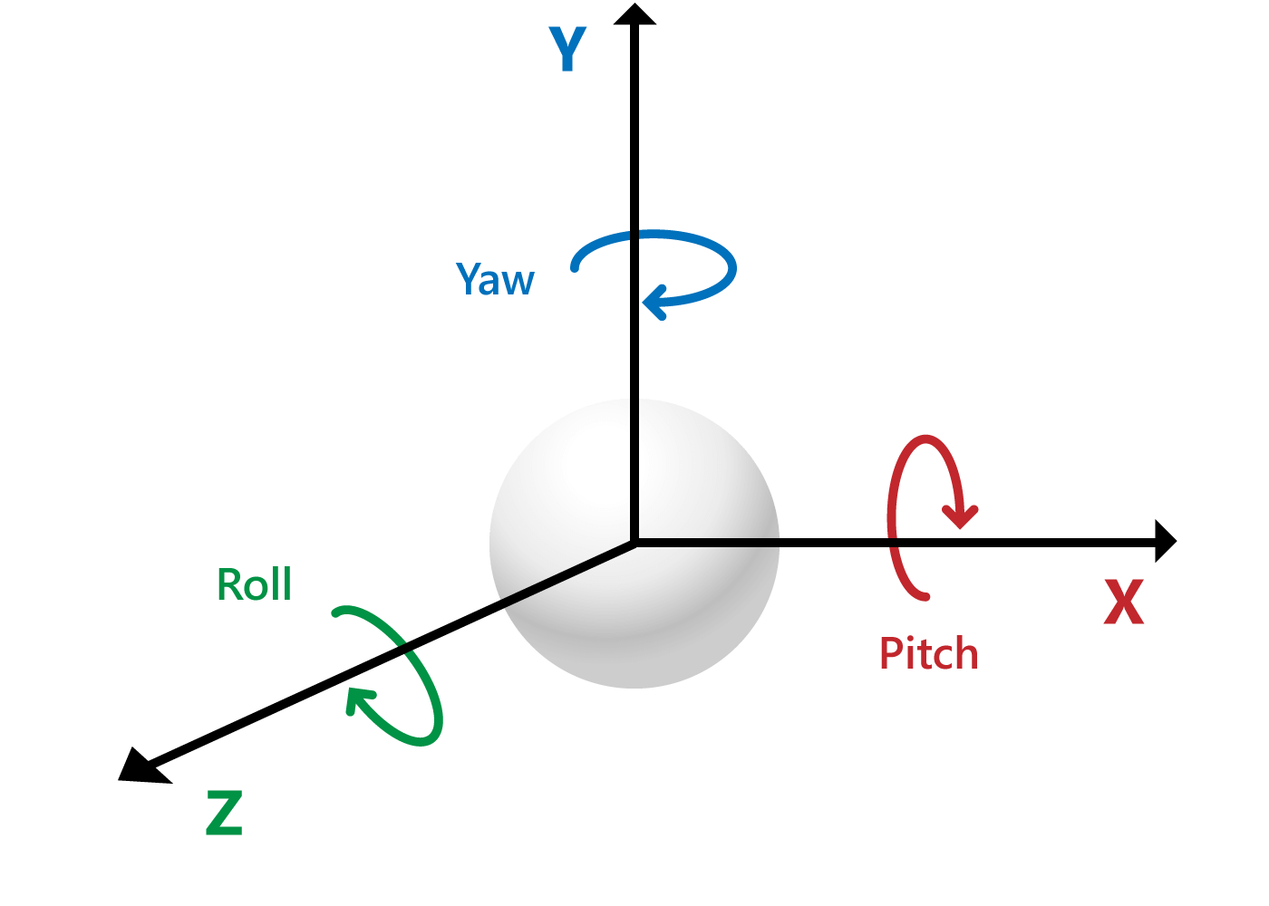
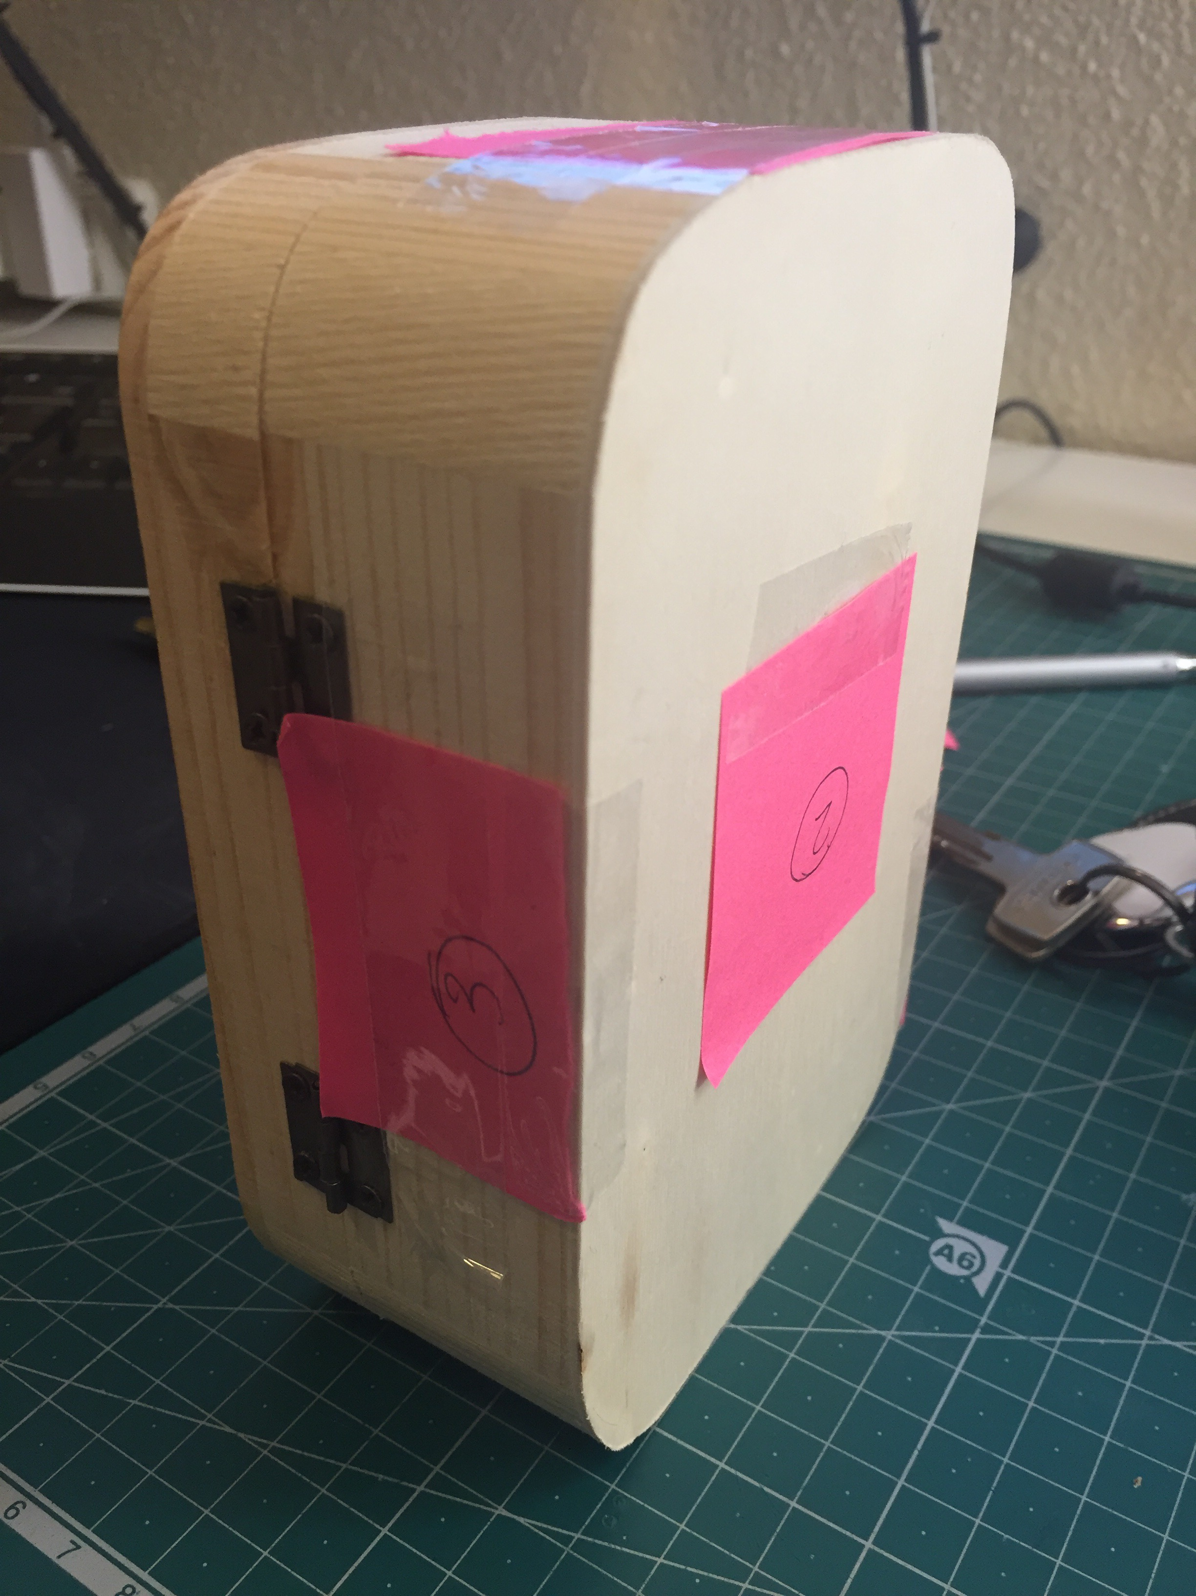
Performance
Continous accelerometer data on screen.
Enclosure for portable function

Slide 15
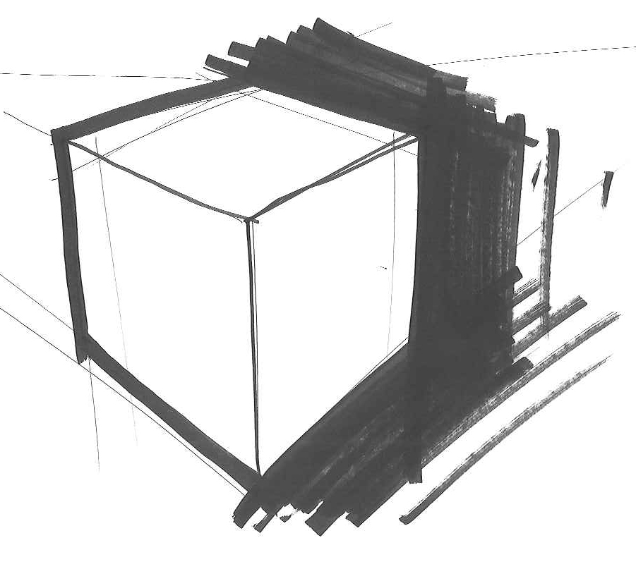
Conclusions
All functionalities work as expected
Minors flaws in design easible fixable
Always use trusted distributors
Isolate posible error sources
The Project is considered a success

Slide 16







Future Work
WiFi Mesh for Domotics

Slide 17
THANK YOU FOR YOUR ATTENTION

